Slide 1
Classifying Game of Thrones Subreddits
Gwen Rathgeber - The Matt
Instructor: Mahdi Shadkam-Farrokhi

Slide 2
Problem Statement
Reddit wants to remove redundant subreddits to improve user experience
r/gameofthrones, r/freefolk, and r/asoiaf moderators insist that they are different spaces despite their shared topic
To test this claim, we will see if we can predict the subreddit of a post

Slide 3
Workflow
PushShift API
Lemma-tize
Model
Evaluate
Cleaned
Data
3 years of posts
Visualize

Slide 4
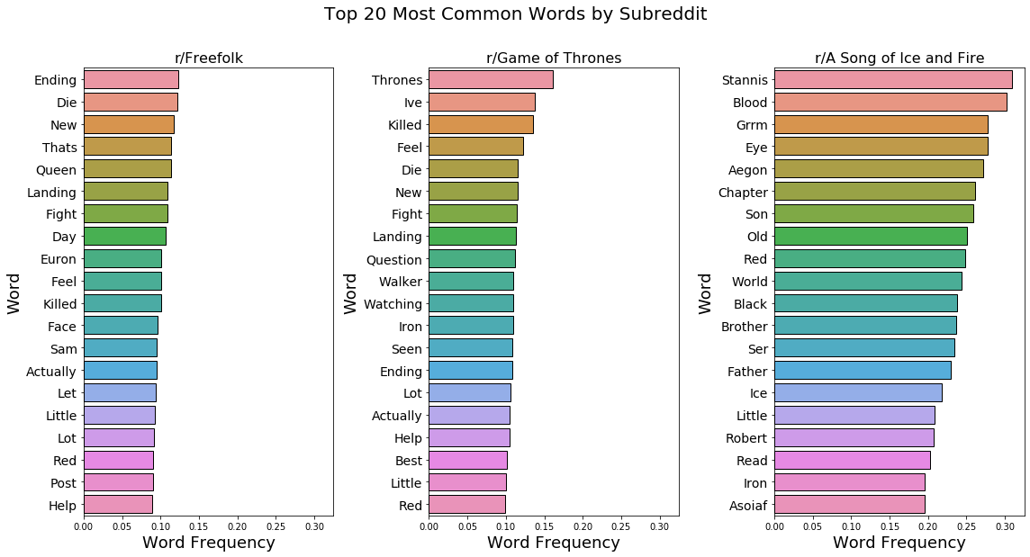
Are there Differences?

Slide 5
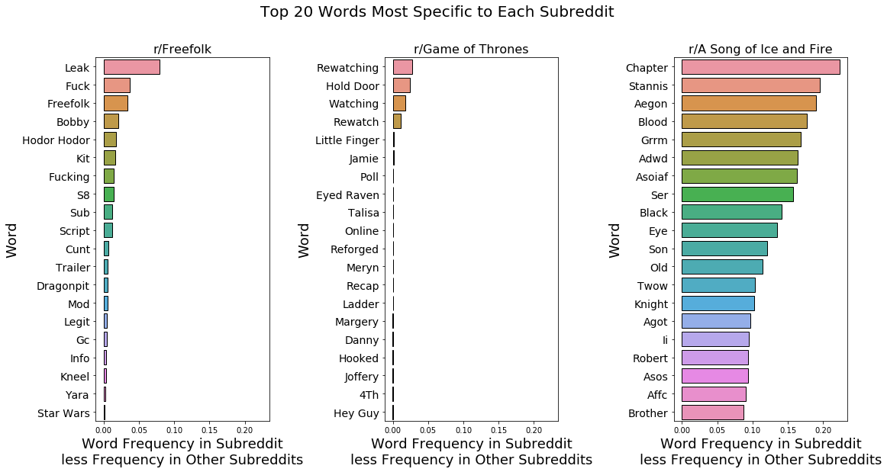
Subreddit-Specific Words

Slide 6
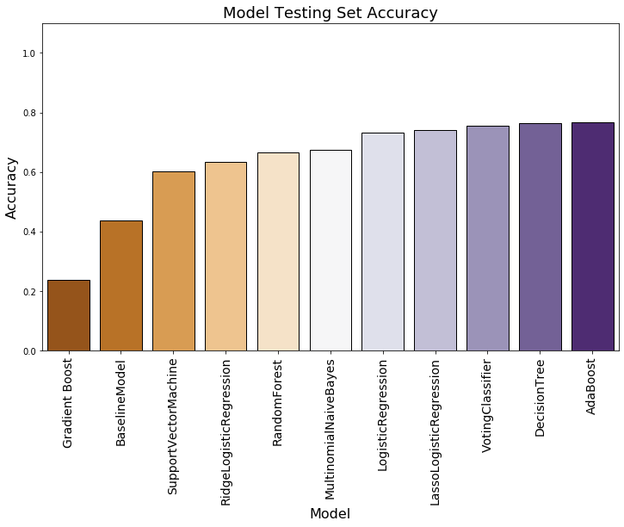
Modeling Results 1
AdaBoost is our overall best model, with the Decision Tree not far behind.
Ensemble didn’t beat our standalones
76.7% Accuracy
43.7%

Slide 7
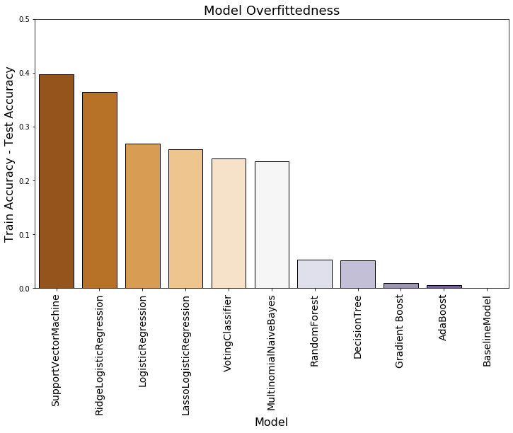
Modeling Results 2

Slide 8
Conclusions and Recommendations
We successfully beat the baseline of 44% accuracy
r/gameofthrones, r/freefolk, and r/asoiaf have substantial differences and can continue to coexist

